Slide 1
SPM

Slide 2
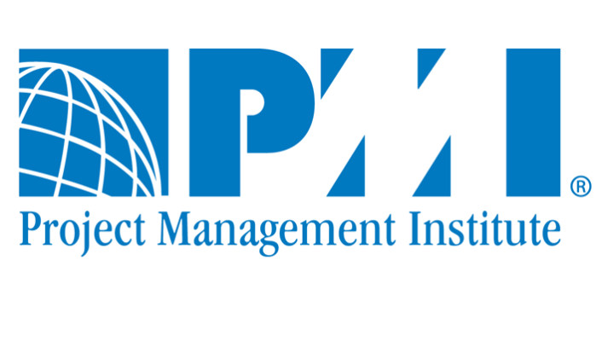
PMI Framework
The PMI (Project Management Institute) framework is a comprehensive approach to project management. It provides a structured and standardized method for managing projects across various industries and domains. PMI is a globally recognized organization that offers project management certifications, including the Project Management Professional (PMP) and Certified Associate in Project Management (CAPM) certifications. Here are some key aspects of the PMI framework:

Slide 3
Project Management Knowledge Areas: PMI defines ten knowledge areas that encompass various aspects of project management. These areas include integration, scope, time, cost, quality, human resources, communications, risk, and stakeholder management. Each knowledge area addresses specific project management functions and processes.
Project Management Processes: Within each knowledge area, PMI outlines a set of processes that help manage different aspects of a project. These processes are organized into five groups: initiating, planning, executing, monitoring and controlling, and closing. These groups provide a structured approach to managing projects from start to finish.

Slide 4
PMBOK Guide: The Project Management Body of Knowledge (PMBOK) is a guide developed by PMI that serves as a foundational reference for project management professionals. It provides detailed information on the ten knowledge areas, project management processes, and best practices for managing projects.
Certifications: PMI offers various project management certifications, with the PMP certification being the most well-known and respected. These certifications validate a professional's knowledge and skills in project management, making them highly sought after in the industry.

Slide 5
Code of Ethics: PMI emphasizes the importance of ethical behavior and professionalism in project management. The organization has a Code of Ethics and Professional Conduct that outlines the ethical responsibilities of project managers.
Global Standards: PMI's framework is recognized and used worldwide, making it a global standard for project management. It provides a common language and set of best practices that can be applied to projects in diverse cultural and organizational contexts.

Slide 6
Community and Resources: PMI offers a supportive community of project management professionals and provides resources such as webinars, publications, and events to facilitate continuous learning and professional development.
The PMI framework is designed to help organizations and professionals achieve successful project outcomes by providing a structured and standardized approach to project management. It promotes best practices, knowledge sharing, and ethical behavior within the field of project management, contributing to the growth and success of the profession.

